Slide 1
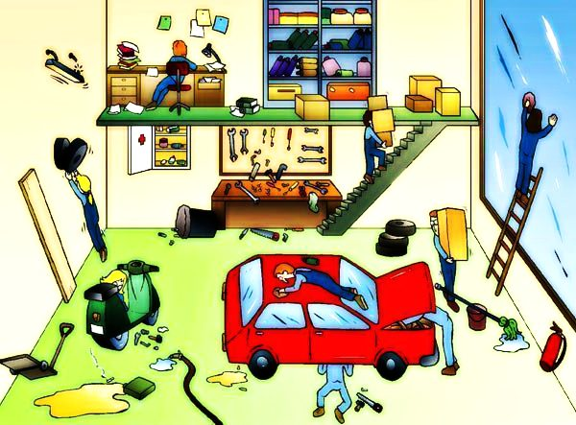
Can you Identify the Hazards in this image?
How many hazards can you find? There are 22.
UPEHS.com | https://www.upehs.com/can-you-identify-the-hazards-in-this-image/

Slide 2
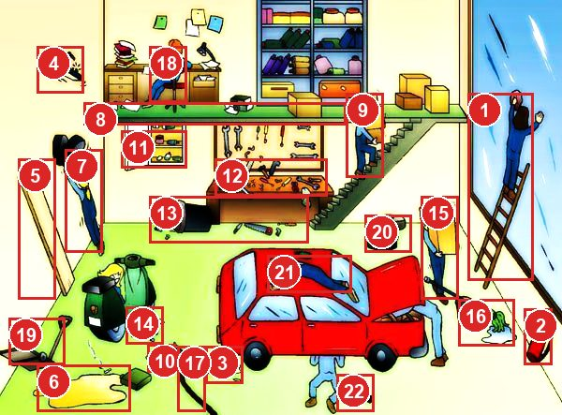
Answers: the 22 hazards
Numbers match the answer key that follows.
UPEHS.com | https://www.upehs.com/can-you-identify-the-hazards-in-this-image/

Slide 3
Answer key
1. Unsafe act: Person resting ladder on the wall/ glass. The ladder is not secured also there is no 3 point contact while working on the ladder.
2. Fire Extinguisher is placed on the floor. This makes it difficult to pick up. Should be ideally 90 cm from the floor level
3. Spilled oil on the floor can become a slip hazard
4. Hanging light can fall on person below
5. Wooden plank resting vertically on the wall has higher chance of falling down. This should be rested horizontally, preferably on the floor where nobody moves
UPEHS.com | https://www.upehs.com/can-you-identify-the-hazards-in-this-image/

Slide 4
Answer key (continued)
6. Flammable liquid and cigarettes can cause fire
7. Placing items in difficult to reach places can cause overstreching and may lead to musculoskeletal disorders
8. No hand railings for the mezzanine floor. Risk of falling from height. Also poor housekeeping on the floor.
9. Front view blocked while moving with load. Also there are no hand railings for the staircase. Risk of falling from height.
10. Spilled liquids can cause slip hazard
UPEHS.com | https://www.upehs.com/can-you-identify-the-hazards-in-this-image/

Slide 5
Answer key (continued)
11. First aid box is left open and medicines can easily get contaminated. Need to keep the first aid box closed.
12. Poorly maintained working table. This makes it more difficult to locate tools and cause delay in completing tasks.
13. Poor Housekeeping
14. Poor Housekeeping
15. Front view blocked while moving with load. Person can trip on material on the floor.
UPEHS.com | https://www.upehs.com/can-you-identify-the-hazards-in-this-image/

Slide 6
Answer key (continued)
16. Spilled liquid and mop placed on the floor can become slip and trip hazard.
17. Hose laid on the floor can become trip and fall hazard.
18. Poor sitting posture can lead to musculoskeletal disorders.
19. Trip and fall Hazard
20. Person has directly climbed on the vehicle and doing cleaning job. He needs to have a ladder to access the car roof without climbing on the roof.
UPEHS.com | https://www.upehs.com/can-you-identify-the-hazards-in-this-image/

Slide 7
Answer key (continued)
21. Poorly placed material which can fall down.
22. Tools will be difficult to reach when required by the mechanic as they are placed far away. Also it can become tripping hazard to others.
UPEHS.com | https://www.upehs.com/can-you-identify-the-hazards-in-this-image/

Slide 8
More free spot-the-hazard quizzes
https://www.upehs.com/category/safety/spot-the-hazard/
Run toolbox talks with your team in POLLE Safety, free safety software that runs in your browser: safety.upehs.com

