Slide 1
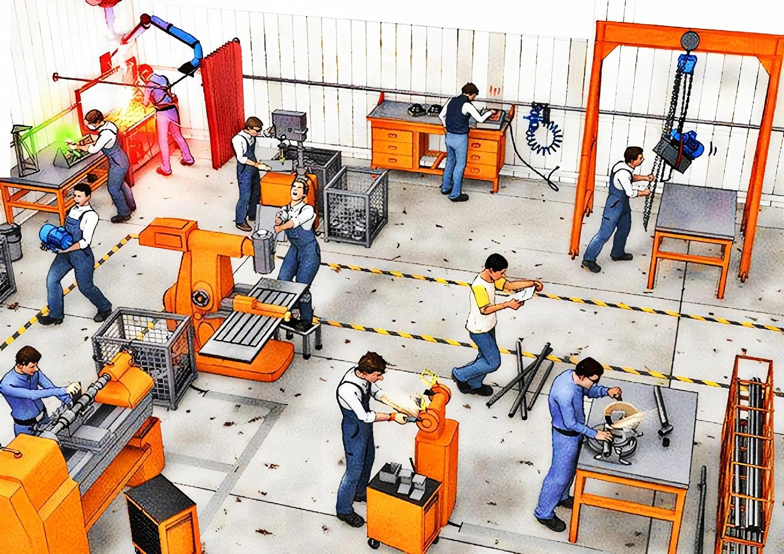
Can you spot all the hazards here?
How many hazards can you find? There are 9.
UPEHS.com | https://www.upehs.com/can-you-spot-all-the-hazards-in-this-image/

Slide 2
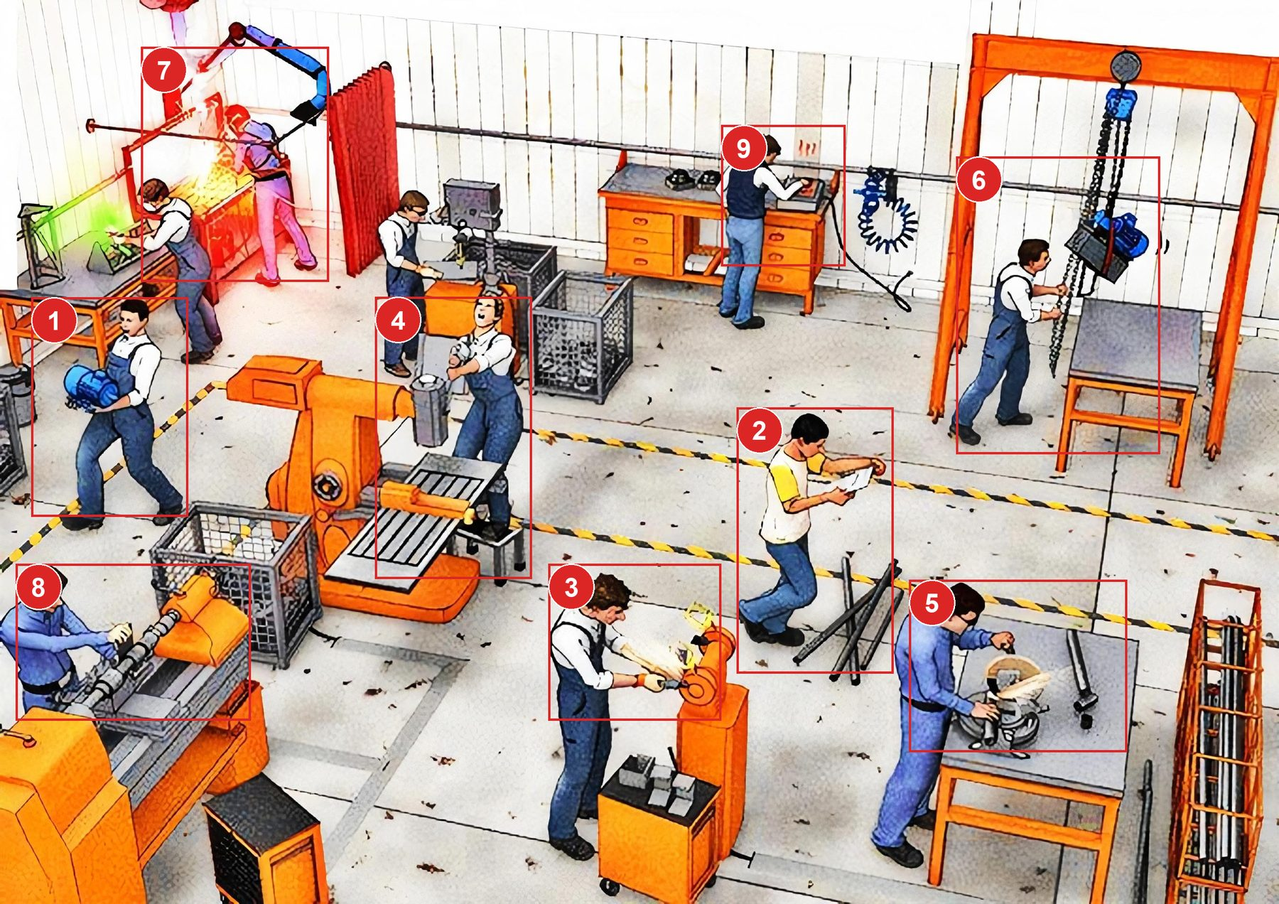
Answers: the 9 hazards
Numbers match the answer key that follows.
UPEHS.com | https://www.upehs.com/can-you-spot-all-the-hazards-in-this-image/

Slide 3
Answer key
1. Risk of Back Injury due to heavy lifting. Use Material Handling Equipment like Trolleys to move heavy objects
2. Risk of trip and fall. Always walk only in the designated pathways. Make sure you focus only on the path ahead while walking
3. Use eye protection glasses while doing grinding as flying sparks may hurt your eyes
4. Exerting excessive force may cause back muscle sprain. Use powered tools/ wrenches to loosen the tight screws. Also standing on a small platform to do operation increases the risk of falling.
5. As the working bench is at lower height the person doing the activity will strain his neck muscles by looking down.
UPEHS.com | https://www.upehs.com/can-you-spot-all-the-hazards-in-this-image/

Slide 4
Answer key (continued)
6. Use of Safety helmet is a must while working directly below a suspended load or lifting equipment.
7. Exhaust suction needs to be directly over the welding area for being effective or the person working will inhale the hazardous smoke generated.
8. Exposure to moving machinery. All rotating/ moving parts need to be guarded to prevent risk of injury.
9. Exposure hot surfaces. Use Heat resistant gloves when doing the operation.
UPEHS.com | https://www.upehs.com/can-you-spot-all-the-hazards-in-this-image/

Slide 5
More free spot-the-hazard quizzes
https://www.upehs.com/category/safety/spot-the-hazard/
Run toolbox talks with your team in POLLE Safety, free safety software that runs in your browser: safety.upehs.com

