Slide 1
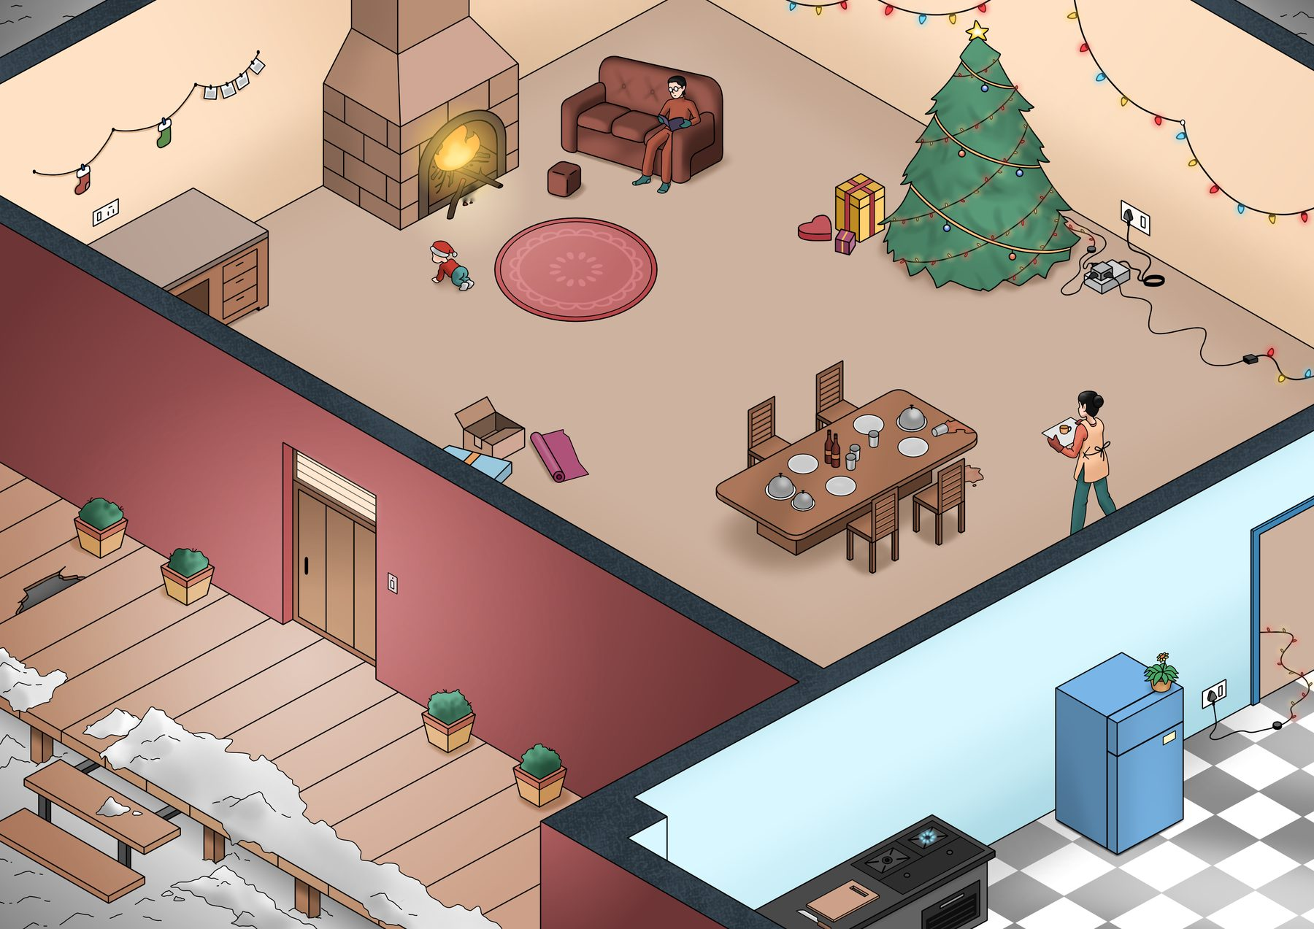
Christmas Safety: Spot the Hazards in Your Festive Setup
How many hazards can you find? There are 11.
UPEHS.com | https://www.upehs.com/christmas-safety-spot-the-hazards-in-your-festive-setup/

Slide 2

Answers: the 11 hazards
Numbers match the answer key that follows.
UPEHS.com | https://www.upehs.com/christmas-safety-spot-the-hazards-in-your-festive-setup/

Slide 3
Answer key
1. Fireplaces pose burn risks from heat and sparks; always use barriers and supervise children closely.
2. Keep all combustible materials like stockings, decorations, or furniture at least three feet away from the fireplace to prevent fires.
3. Overloading sockets can cause overheating and electrical fires; always use surge protectors and avoid plugging in too many high-power devices.
4. Spilled water creates a slip-and-fall hazard, especially when unnoticed; clean spills immediately to prevent accidents.
5. Always use a fireplace screen or door to contain burning wood and prevent accidents.
UPEHS.com | https://www.upehs.com/christmas-safety-spot-the-hazards-in-your-festive-setup/

Slide 4
Answer key (continued)
6. A broken or damaged plank poses a trip-and-fall risk, especially during festivities when foot traffic increases.
7. Ice-covered surfaces create a significant slip hazard, especially at entry points where people are likely to tread
8. Ensure the stove is never left unattended.
9. Ensure Christmas light wires are securely taped down and placed out of walkways to prevent tripping hazards during holiday celebrations.
10. Place flower pots securely on stable surfaces away from the fridge to prevent them from falling and causing injury when the fridge is opened.
UPEHS.com | https://www.upehs.com/christmas-safety-spot-the-hazards-in-your-festive-setup/

Slide 5
Answer key (continued)
11. Keep Christmas gift boxes organized and off the floor to avoid tripping hazards and maintain a safe environment during holiday preparations.
UPEHS.com | https://www.upehs.com/christmas-safety-spot-the-hazards-in-your-festive-setup/

Slide 6
More free spot-the-hazard quizzes
https://www.upehs.com/category/safety/spot-the-hazard/
Run toolbox talks with your team in POLLE Safety, free safety software that runs in your browser: safety.upehs.com

