Slide 1
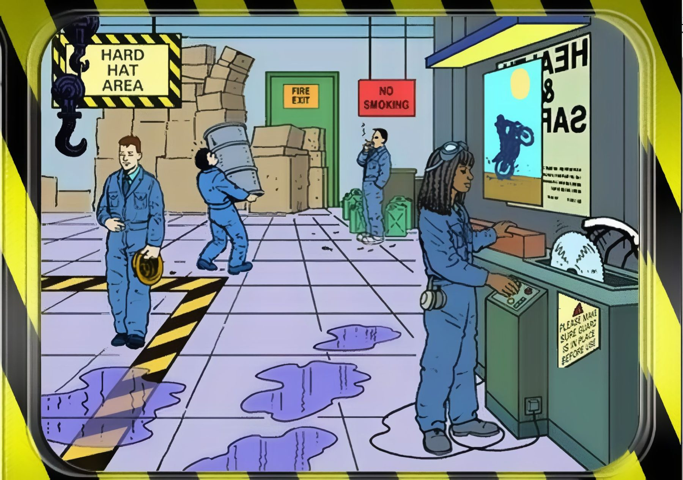
Spot the Hazard Interactive Quiz - 6
How many hazards can you find? There are 13.
UPEHS.com | https://www.upehs.com/identify-the-hazard-interactive-quiz-workplace-safety/

Slide 2

Answers: the 13 hazards
Numbers match the answer key that follows.
UPEHS.com | https://www.upehs.com/identify-the-hazard-interactive-quiz-workplace-safety/

Slide 3
Answer key
1. No anti-slip device for the lifting hook
2. Not wearing ear ptotection
3. Safety guard is not in place
4. Smoking in a No Smoking zone
5. Not wearing eye protection
UPEHS.com | https://www.upehs.com/identify-the-hazard-interactive-quiz-workplace-safety/

Slide 4
Answer key (continued)
6. Boxes blocking the fire exit
7. Poor manual handling of equipment
8. Poor Health and safety signage
9. Boxes stacked too high and poorly
10. Spills on the ground are not cleaned up
UPEHS.com | https://www.upehs.com/identify-the-hazard-interactive-quiz-workplace-safety/

Slide 5
Answer key (continued)
11. Wire is wrapped around her feet
12. Standing in restricted area
13. Not wearing safety helmet
UPEHS.com | https://www.upehs.com/identify-the-hazard-interactive-quiz-workplace-safety/

Slide 6
More free spot-the-hazard quizzes
https://www.upehs.com/category/safety/spot-the-hazard/
Run toolbox talks with your team in POLLE Safety, free safety software that runs in your browser: safety.upehs.com

