Slide 1
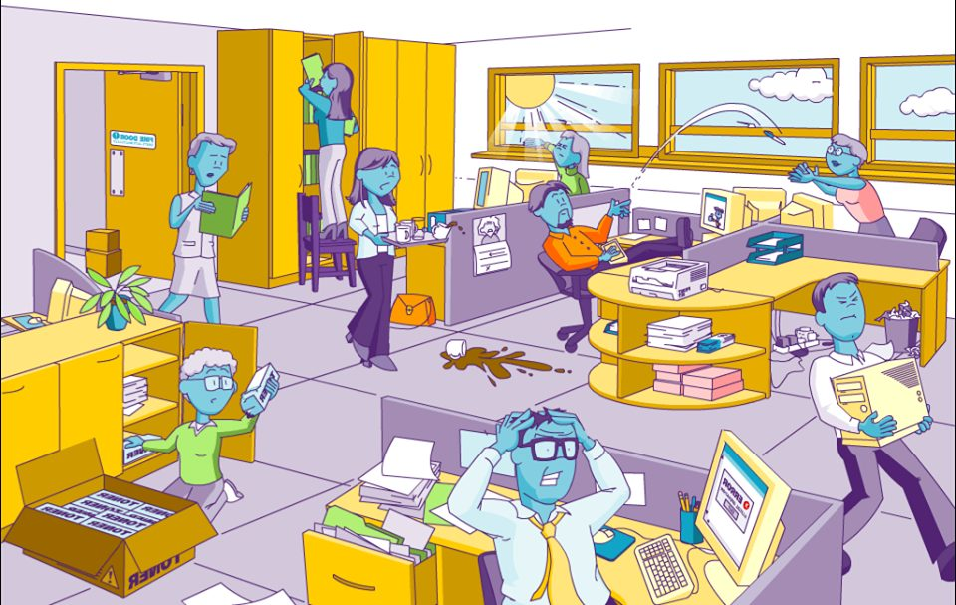
Office Safety: How to Spot the Hazards? Free Interactive game
How many hazards can you find? There are 14.
UPEHS.com | https://www.upehs.com/safety-at-the-office-how-to-spot-the-hazards-a-blog-post-explaining-the-common-hazards-that-can-be-found-in-the-workplace/

Slide 2
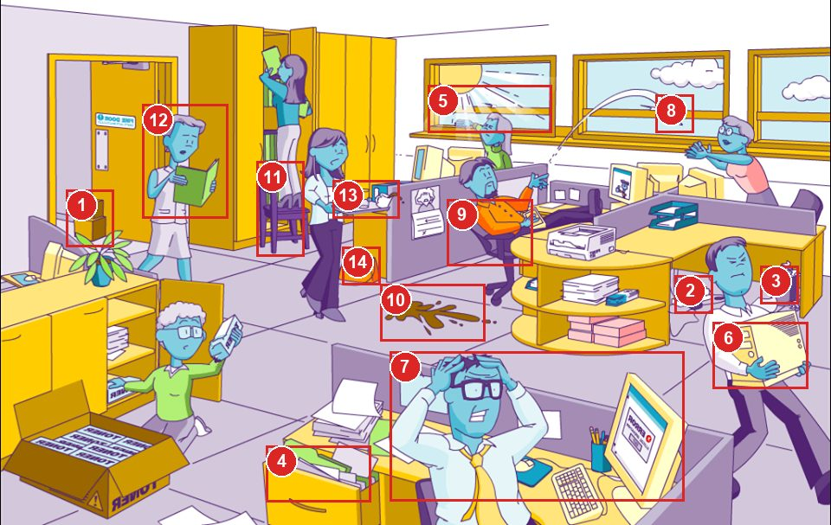
Answers: the 14 hazards
Numbers match the answer key that follows.
UPEHS.com | https://www.upehs.com/safety-at-the-office-how-to-spot-the-hazards-a-blog-post-explaining-the-common-hazards-that-can-be-found-in-the-workplace/

Slide 3
Answer key
1. Fire door has been kept open using boxes, due to this, during fire emergency, the fire will spread to other areas very quickly.
2. Overloaded electrical supply board which may lead to overheating and cause fire
3. Overflowing waste bins add to fire load
4. Over loaded file drawers which keeps the drawer open can strike a person when he/ she is moving around.
5. Windows without sun glazing can cause glaring and eye strain when working at the desk continuously.
UPEHS.com | https://www.upehs.com/safety-at-the-office-how-to-spot-the-hazards-a-blog-post-explaining-the-common-hazards-that-can-be-found-in-the-workplace/

Slide 4
Answer key (continued)
6. Heavy load lifting can cause backache. Use material handling equipment like trolleys or get help..
7. Mental stress caused by malfunctioning of computer. Faster IT response to such conditions can prevent aggravation of such conditions.
8. Flicking of stationery material in the office can cause injuries if it missed.
9. Bending the chair back excessively can cause the chair to fall
10. Spilled liquid can create a slip and fall hazard.
UPEHS.com | https://www.upehs.com/safety-at-the-office-how-to-spot-the-hazards-a-blog-post-explaining-the-common-hazards-that-can-be-found-in-the-workplace/

Slide 5
Answer key (continued)
11. Use of chair in place ladder can create risk of fall.
12. Not focusing on the path of movement is a risky behavior..
13. Overloaded tray of tea has more probability of spilling.
14. Personal belongings to placed inside drawers, here it is causing tripping hazard.
UPEHS.com | https://www.upehs.com/safety-at-the-office-how-to-spot-the-hazards-a-blog-post-explaining-the-common-hazards-that-can-be-found-in-the-workplace/

Slide 6
More free spot-the-hazard quizzes
https://www.upehs.com/category/safety/spot-the-hazard/
Run toolbox talks with your team in POLLE Safety, free safety software that runs in your browser: safety.upehs.com

