Slide 1
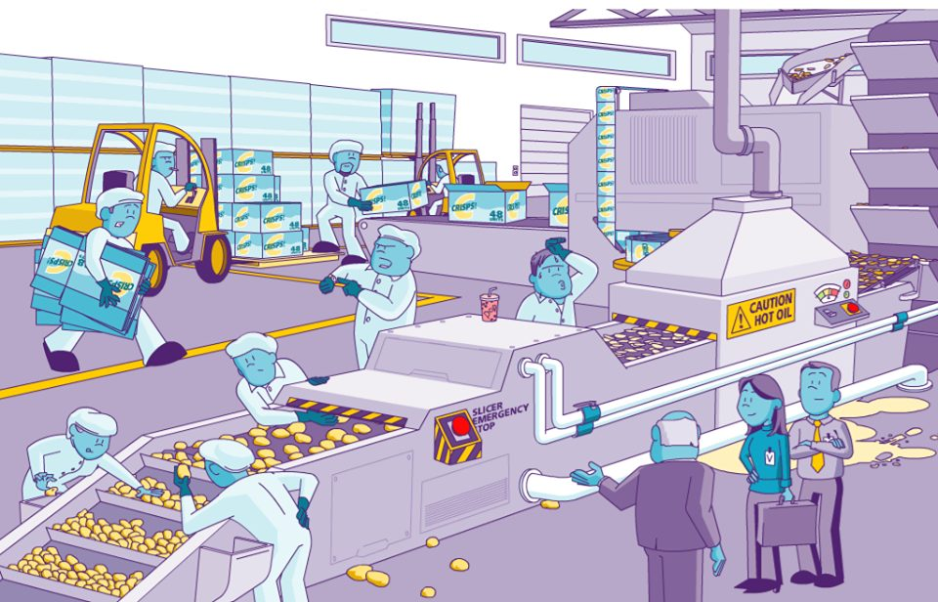
Workplace Hazard Interactive Quiz -7
How many hazards can you find? There are 12.
UPEHS.com | https://www.upehs.com/spot-the-hazard-food-industry/

Slide 2
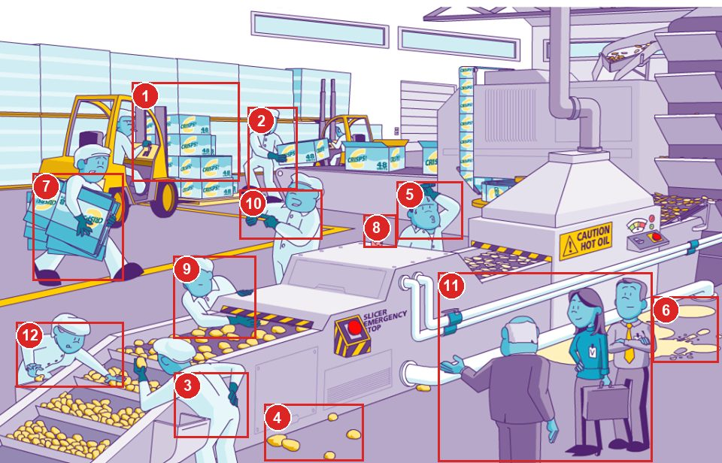
Answers: the 12 hazards
Numbers match the answer key that follows.
UPEHS.com | https://www.upehs.com/spot-the-hazard-food-industry/

Slide 3
Answer key
1. Forklift operator's field of vision is not clear due to stacking of material above eye level.
2. Twisting motion and poor positioning can lead to MSD
3. Poor posture can lead to MSD (Backache)
4. There is poor housekeeping in the area
5. Sweating person without head gear can contaminate food products. Consider providing him with a Fan
UPEHS.com | https://www.upehs.com/spot-the-hazard-food-industry/

Slide 4
Answer key (continued)
6. Hot oil spilled in the area can cause slip and burn hazards
7. Poor method of handling of material can cause an accident
8. No other foods to be permitted in the food processing area
9. Person putting hand in slicer can get severely injured
10. Putting timebound pressure on workers can cause people to work hurriedly and cause an accident.
UPEHS.com | https://www.upehs.com/spot-the-hazard-food-industry/

Slide 5
Answer key (continued)
11. Visitors and escort are not using any headgears and gloves to prevent food contamination (GMP)
12. Gloves are not being used by this employee which can cause food contamination
UPEHS.com | https://www.upehs.com/spot-the-hazard-food-industry/

Slide 6
More free spot-the-hazard quizzes
https://www.upehs.com/category/safety/spot-the-hazard/
Run toolbox talks with your team in POLLE Safety, free safety software that runs in your browser: safety.upehs.com

