Slide 1
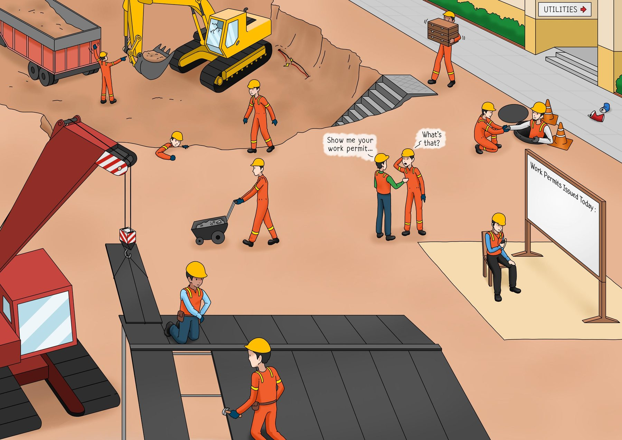
Spot the Hazard Interactive Quiz -1
How many hazards can you find? There are 16.
UPEHS.com | https://www.upehs.com/spot-the-hazard-interactive-quiz-1/

Slide 2
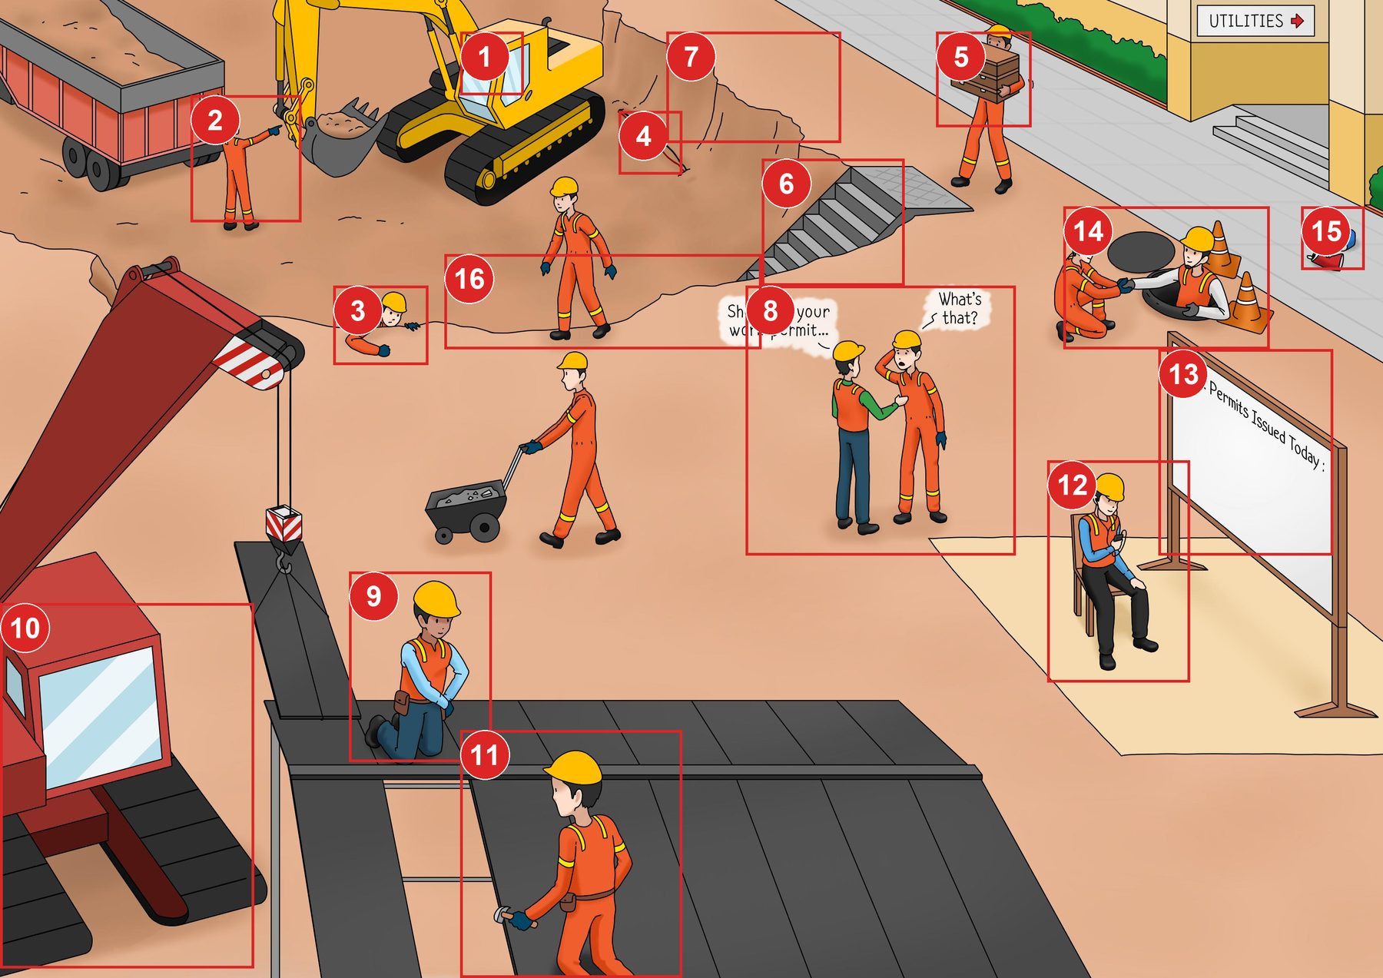
Answers: the 16 hazards
Numbers match the answer key that follows.
UPEHS.com | https://www.upehs.com/spot-the-hazard-interactive-quiz-1/

Slide 3
Answer key
1. Damaged glass of the excavator.
2. Person very close to the moving equipment
3. Person trying to take shortcut
4. Exposed electrical cables
5. Vision blocked by load being carried.
UPEHS.com | https://www.upehs.com/spot-the-hazard-interactive-quiz-1/

Slide 4
Answer key (continued)
6. No Hand Railings.
7. No Barricading - person can fall from height
8. Contractor unaware of Work permit procedures
9. Working on roof without fall protection
10. No Signalman / Spotter to guide the crane load
UPEHS.com | https://www.upehs.com/spot-the-hazard-interactive-quiz-1/

Slide 5
Answer key (continued)
11. Working on roof without fall protection
12. Worker distracted using earphones/ smartphone
13. No Work Permits issued
14. Unregulated confined space work. No Proper equipment used.
15. Trash in pathway
UPEHS.com | https://www.upehs.com/spot-the-hazard-interactive-quiz-1/

Slide 6
Answer key (continued)
16. No Barricading - Person can fall from height
UPEHS.com | https://www.upehs.com/spot-the-hazard-interactive-quiz-1/

Slide 7
More free spot-the-hazard quizzes
https://www.upehs.com/category/safety/spot-the-hazard/
Run toolbox talks with your team in POLLE Safety, free safety software that runs in your browser: safety.upehs.com

