Slide 1
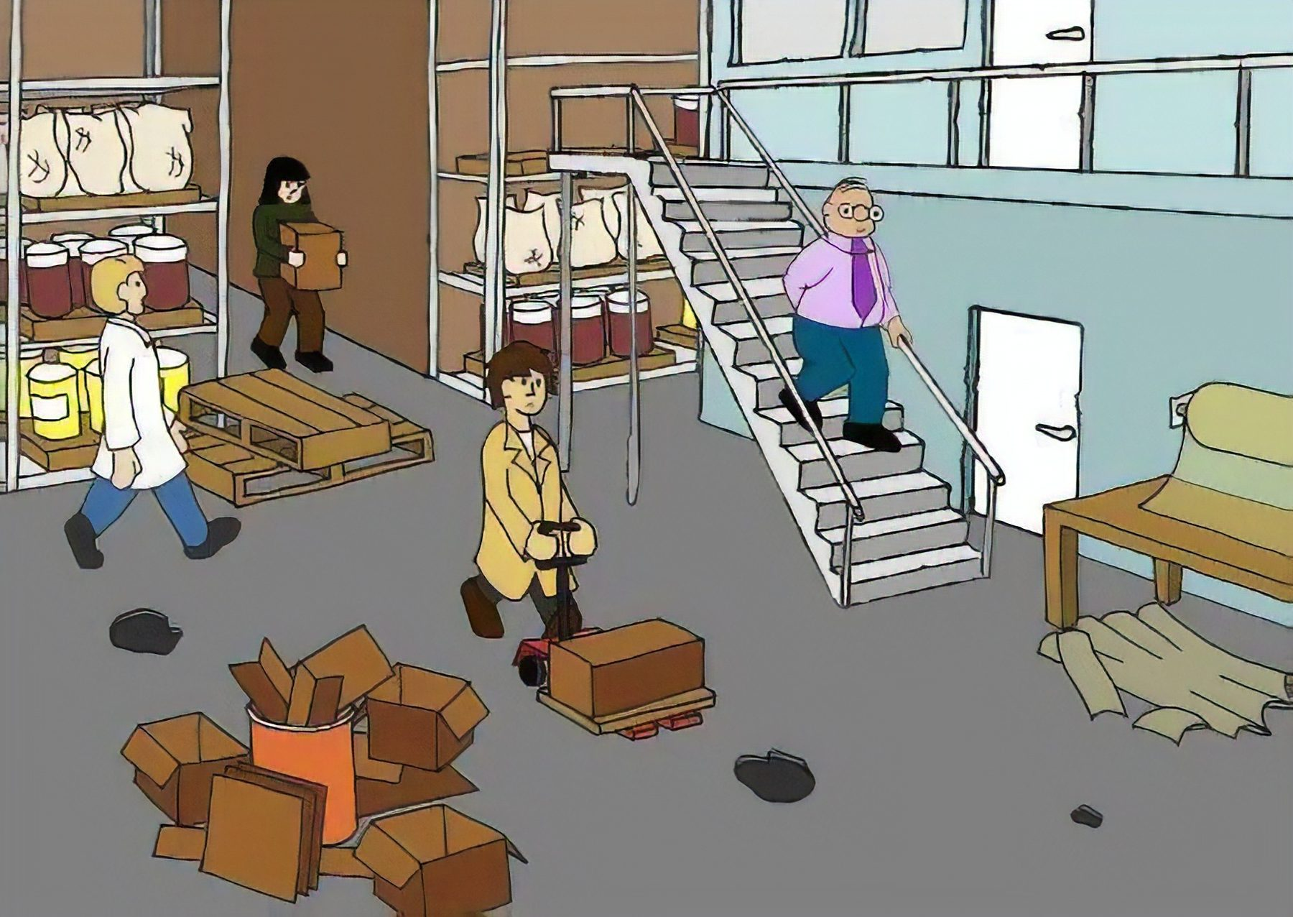
SPOT THE HAZARD INTERACTIVE QUIZ - 2
How many hazards can you find? There are 9.
UPEHS.com | https://www.upehs.com/spot-the-hazard-interactive-quiz-2/

Slide 2

Answers: the 9 hazards
Numbers match the answer key that follows.
UPEHS.com | https://www.upehs.com/spot-the-hazard-interactive-quiz-2/

Slide 3
Answer key
1. Damaged flooring can cause trip and fall hazard for man and machine.
2. Poor housekeeping is a Hazard!!
3. Railing without toe guard for railing is a hazard
4. Material without names is a Hazard
5. Material without names is a Hazard
UPEHS.com | https://www.upehs.com/spot-the-hazard-interactive-quiz-2/

Slide 4
Answer key (continued)
6. Poorly held material can fall easily.
7. Tripping hazard.
8. Material stacked in pathway
9. Damaged floor is a hazard
UPEHS.com | https://www.upehs.com/spot-the-hazard-interactive-quiz-2/

Slide 5
More free spot-the-hazard quizzes
https://www.upehs.com/category/safety/spot-the-hazard/
Run toolbox talks with your team in POLLE Safety, free safety software that runs in your browser: safety.upehs.com

