Slide 1
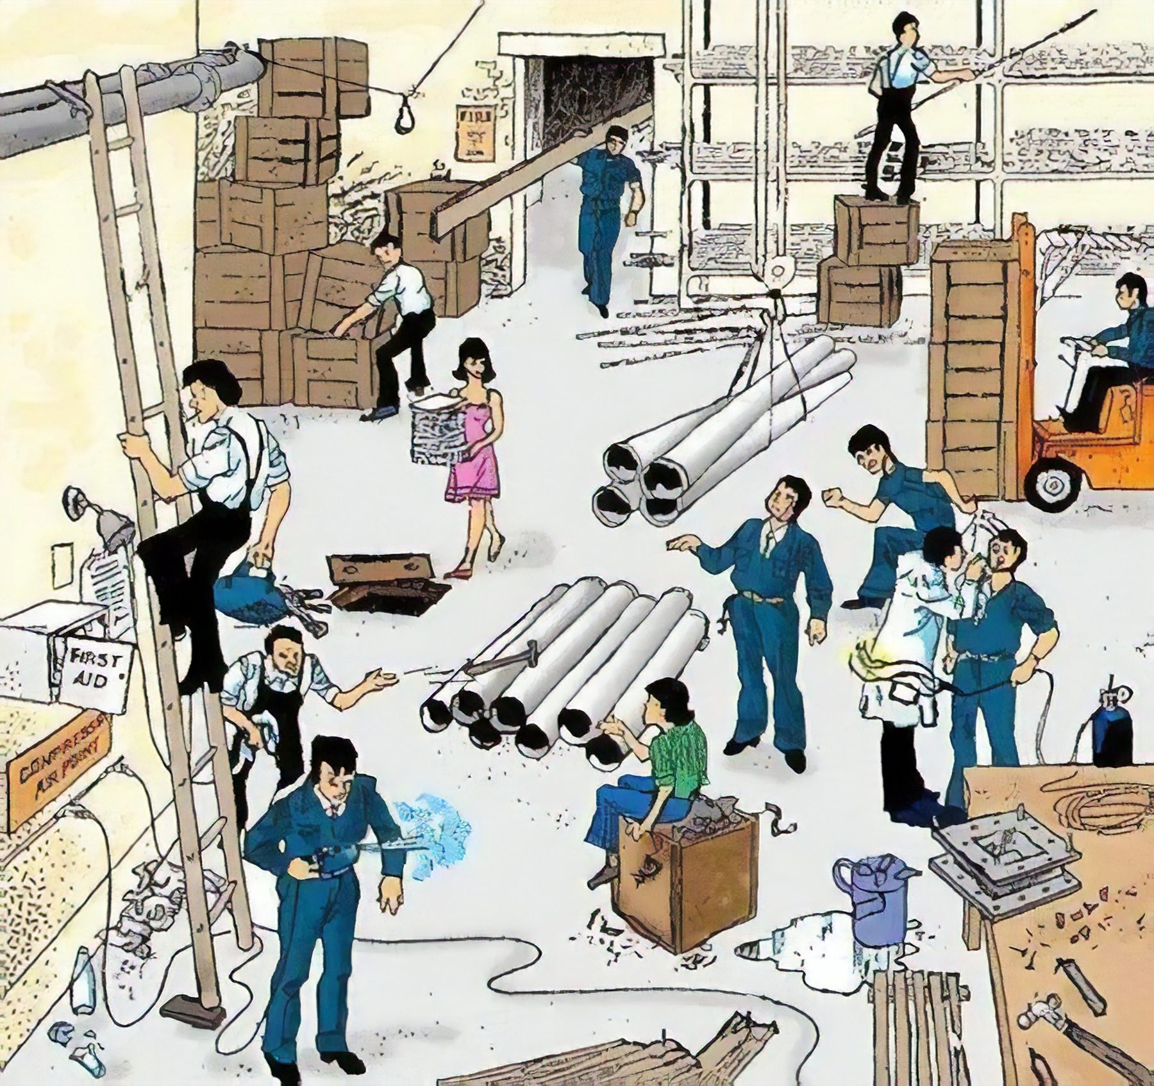
Spot the Hazard Interactive Quiz -4
How many hazards can you find? There are 26.
UPEHS.com | https://www.upehs.com/spot-the-hazard-interactive-quiz-4/

Slide 2
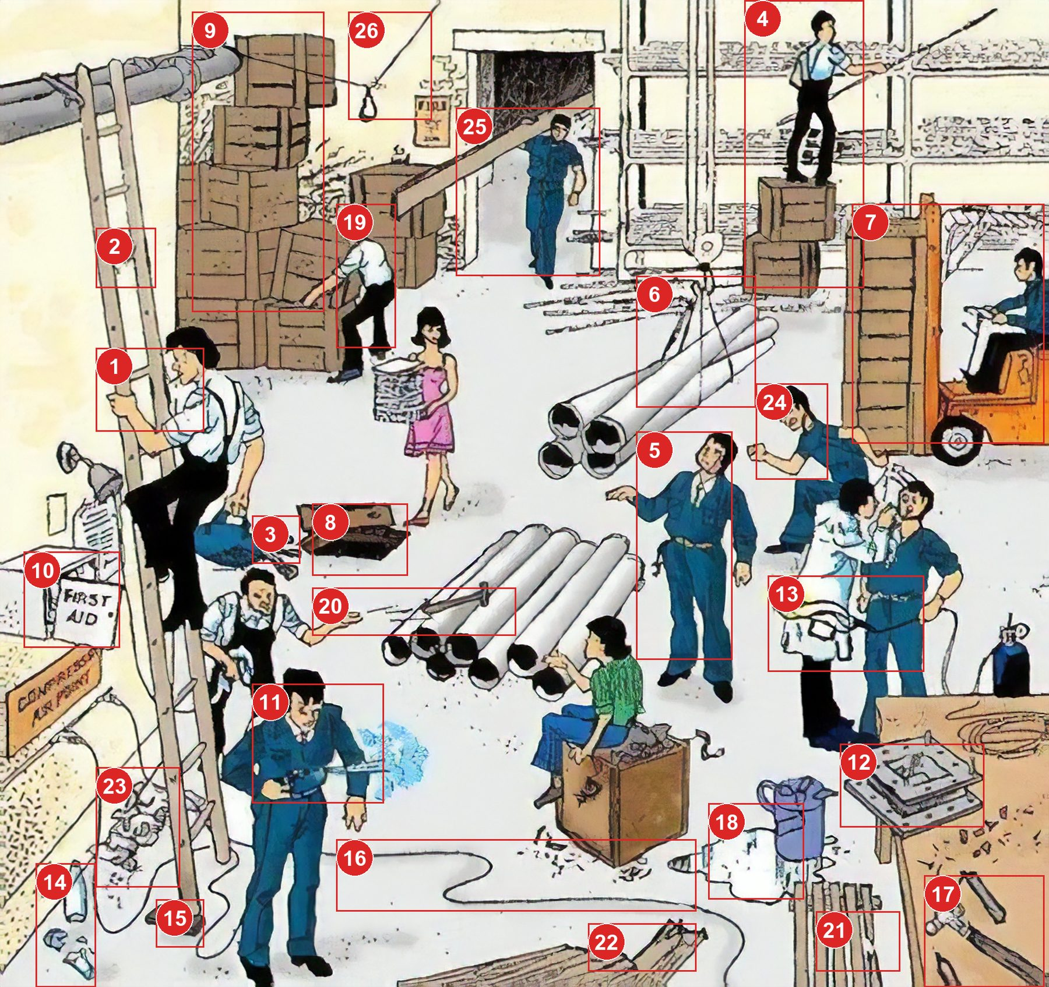
Answers: the 26 hazards
Numbers match the answer key that follows.
UPEHS.com | https://www.upehs.com/spot-the-hazard-interactive-quiz-4/

Slide 3
Answer key
1. No three point contact on the ladder
2. Damaged ladder
3. Material falling from height
4. Risk of person falling due to improper access platform
5. Person standing directly under load being lifted
UPEHS.com | https://www.upehs.com/spot-the-hazard-interactive-quiz-4/

Slide 4
Answer key (continued)
6. Poorly secured load
7. Blocked vision of forklift operator
8. Cut out on floor, fall hazard
9. Poorly stacked load
10. Damaged First aid Box
UPEHS.com | https://www.upehs.com/spot-the-hazard-interactive-quiz-4/

Slide 5
Answer key (continued)
11. Person using compressed air for cleaning body, can cause air embolism
12. poorly placed load at the edge of table can fall down
13. Open flame of Oxy gas cutter
14. Damaged glass can cause injury
15. Poorly placed ladder
UPEHS.com | https://www.upehs.com/spot-the-hazard-interactive-quiz-4/

Slide 6
Answer key (continued)
16. Trip and fall hazard due to cables
17. Damaged Tools
18. Spilled liquid, slip and fall hazard
19. Person doing manual handling of heavy load
20. Throwing tools can cause injury
UPEHS.com | https://www.upehs.com/spot-the-hazard-interactive-quiz-4/

Slide 7
Answer key (continued)
21. Damaged Pallet
22. Protruding nails
23. Poor Housekeeping
24. Person running on shop floor
25. Person lifting load with poor center of gravity. Two persons should have been employed
UPEHS.com | https://www.upehs.com/spot-the-hazard-interactive-quiz-4/

Slide 8
Answer key (continued)
26. Poor wiring for light
UPEHS.com | https://www.upehs.com/spot-the-hazard-interactive-quiz-4/

Slide 9
More free spot-the-hazard quizzes
https://www.upehs.com/category/safety/spot-the-hazard/
Run toolbox talks with your team in POLLE Safety, free safety software that runs in your browser: safety.upehs.com

