Slide 1
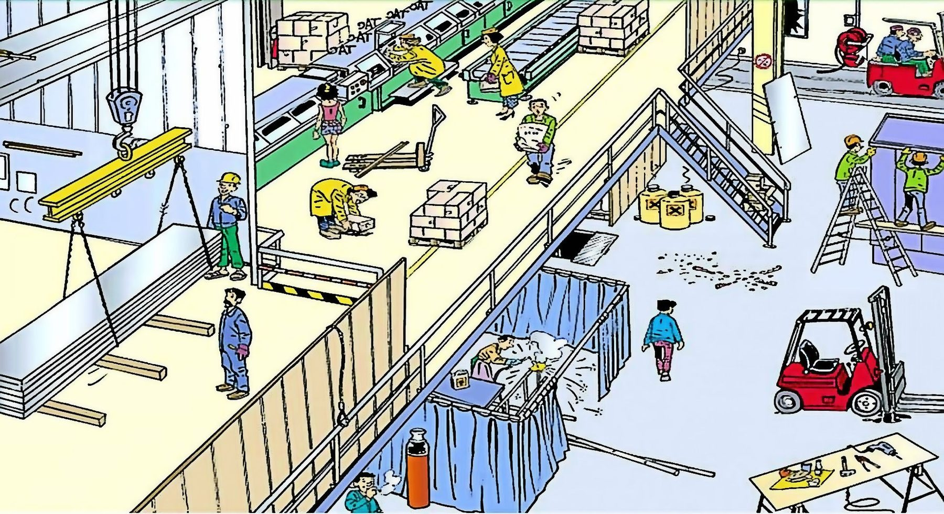
Spot the Hazard Interactive Quiz - 5
How many hazards can you find? There are 27.
UPEHS.com | https://www.upehs.com/spot-the-hazard-interactive-quiz-5/

Slide 2
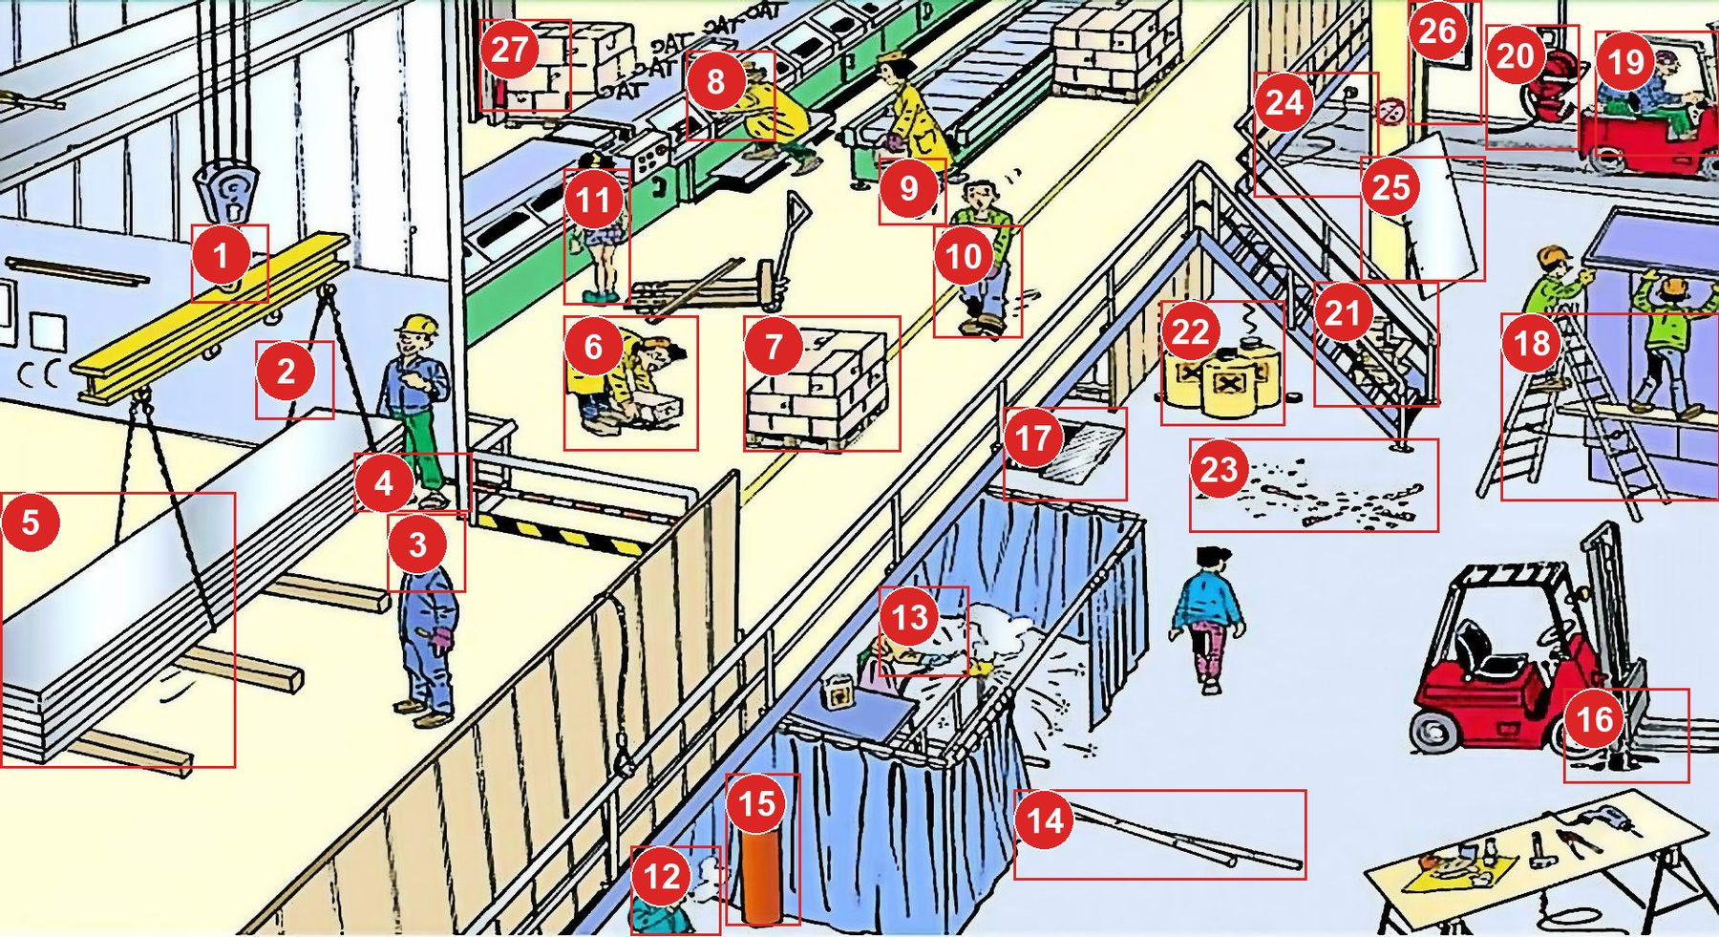
Answers: the 27 hazards
Numbers match the answer key that follows.
UPEHS.com | https://www.upehs.com/spot-the-hazard-interactive-quiz-5/

Slide 3
Answer key
1. No Anti Slip Device for the lifting hook.
2. Damaged Lifting Sling.
3. No Safety Helmet.
4. No Safety Shoes.
5. Poorly Distributed Load can topple.
UPEHS.com | https://www.upehs.com/spot-the-hazard-interactive-quiz-5/

Slide 4
Answer key (continued)
6. Poor Lifting technique.
7. Material Kept in the passage.
8. Working on moving machinery.
9. Incorrect Shoes at workplace.
10. Not using material handling equipment with heavy load.
UPEHS.com | https://www.upehs.com/spot-the-hazard-interactive-quiz-5/

Slide 5
Answer key (continued)
11. Incorrect clothes at workplace.
12. Smoking at workplace.
13. No welding glasses.
14. Trip and Fall Hazard.
15. Non secured cylinder.
UPEHS.com | https://www.upehs.com/spot-the-hazard-interactive-quiz-5/

Slide 6
Answer key (continued)
16. Leaking forklift oil.
17. Exposed floor opening.
18. Unsafe Scaffolding/ Ladder.
19. Extra rider on Forklift.
20. Damaged Fire Hose.
UPEHS.com | https://www.upehs.com/spot-the-hazard-interactive-quiz-5/

Slide 7
Answer key (continued)
21. Material on the stairs.
22. Volatile Chemicals kept without covers.
23. Poor Housekeeping.
24. Cable in the passage.
25. Material leaning against the wall.
UPEHS.com | https://www.upehs.com/spot-the-hazard-interactive-quiz-5/

Slide 8
Answer key (continued)
26. Damaged window glass.
27. Blocked fire extinguisher
UPEHS.com | https://www.upehs.com/spot-the-hazard-interactive-quiz-5/

Slide 9
More free spot-the-hazard quizzes
https://www.upehs.com/category/safety/spot-the-hazard/
Run toolbox talks with your team in POLLE Safety, free safety software that runs in your browser: safety.upehs.com

